Slide 1
Redesigning WebSTAC
Milestone 4

Slide 2
Project Goals
Design a UI for students to enroll for classes, view their schedule, their academic progress
System should be able to accomplish all features needed for a student to register
Both functionally, but also should include ideal features students requested
Including features not currently in WebSTAC
Scope of project was not the entirety of WebSTAC, merely creating a registration system

Slide 3
Project Features as of Milestone 3
Ability to search for classes by name and school/department
Can filter classes by undergrad/grad level, needed requirements, and weekday
Users can leave anonymous reviews for their classes
Course listings give details, descriptions, and show previous student’s reviews
Academic calendar, current schedule, needed course requirements

Slide 4
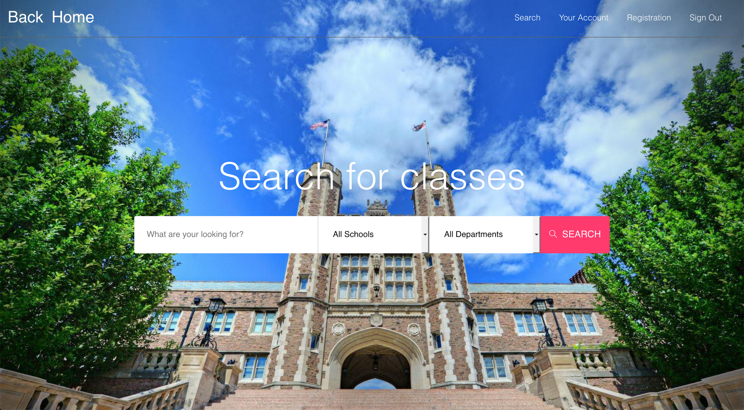
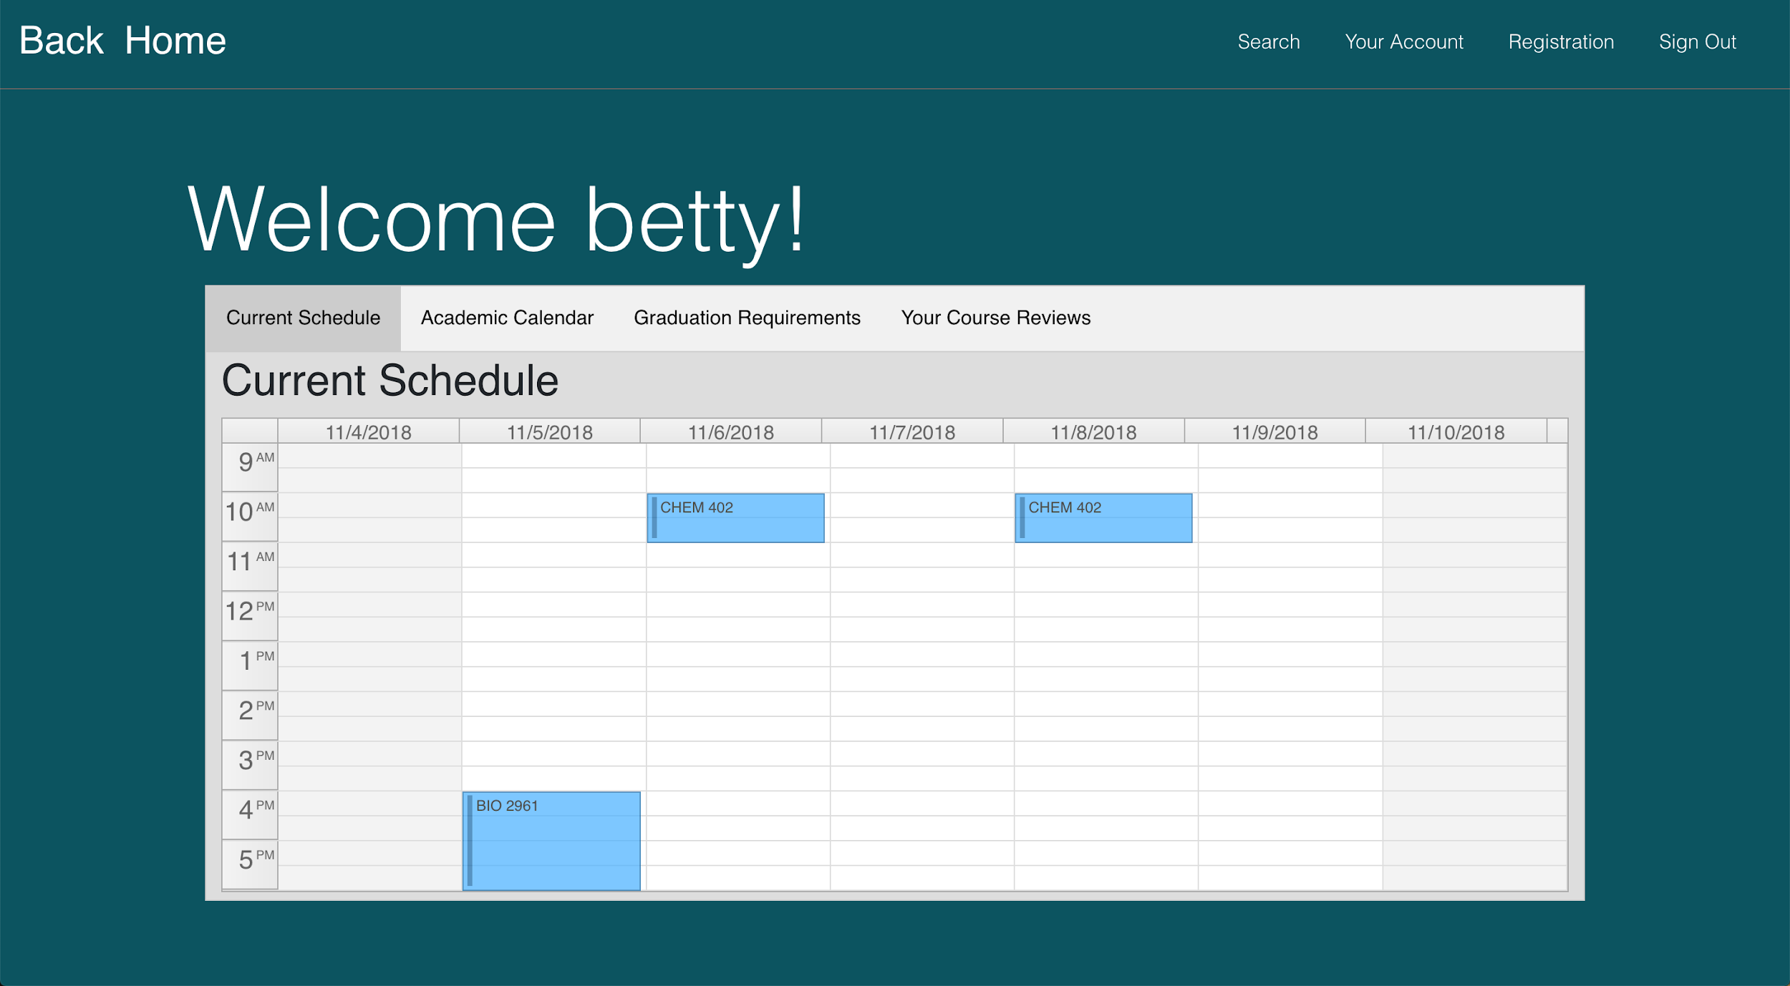

Slide 5
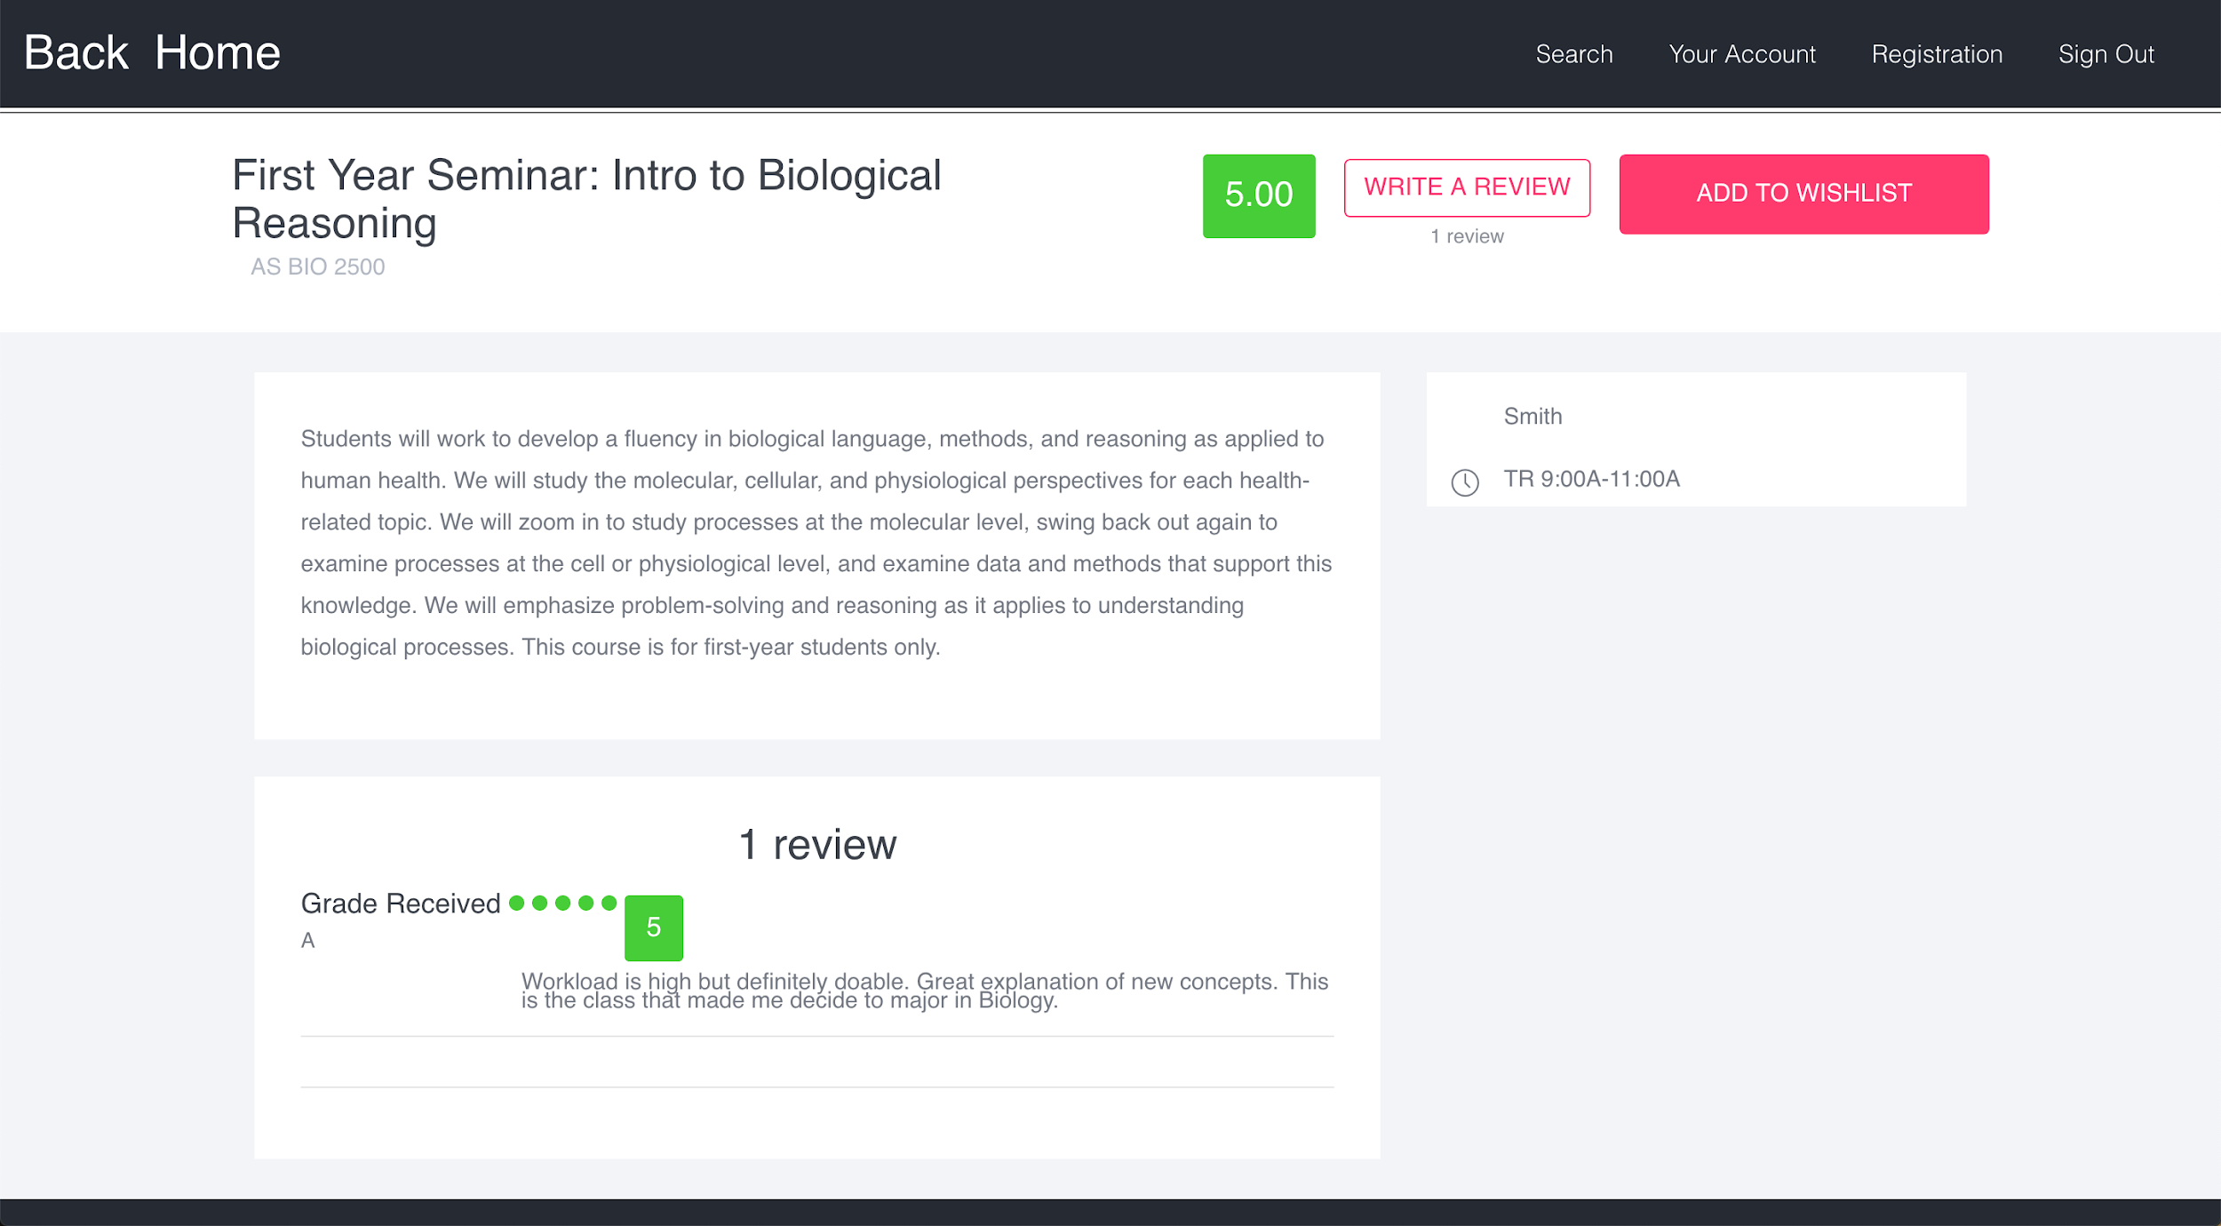
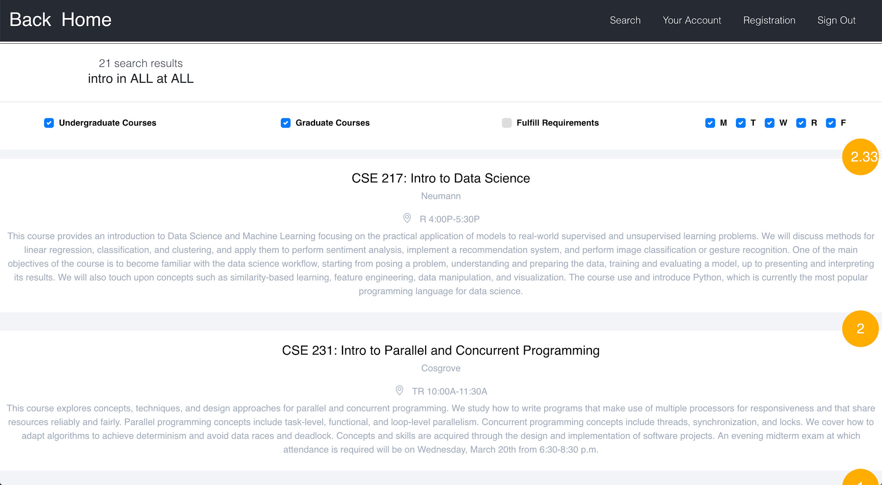

Slide 6
Milestone 4 Feedback Process
Three rounds of user feedback
First and last rounds were user testing, each with three participants
Second round was non-user based evaluation (cognitive walkthrough)
User Demographics
1 sophomore, 2 juniors, 2 seniors, and 2 graduate students
3 Engineering students, 1 undecided, 3 arts & sciences

Slide 7
Milestone 4 Tasks
1. You are a Biology major at WashU with the username "betty". You are currently enrolled in BIO 2961 - Collaborative Phage Bioinformatics. You are currently getting a "D" in the course and are not enjoying it very much, so you wish to drop. Before you drop however, you want to write a review for the course to let future students know how you feel.
2. You are the same user "betty" as before. You now need another class to enroll in after dropping BIO 2961, and you've heard your friends talk about a BIO 3041 class that they loved and you want to find more details about it to decide whether or not to register for it.
3. You are a Law student by the username "seth". You already have a registration worksheet ready and waiting that you have prepared, but you need to complete the registration process quickly to make sure you aren't waitlisted.
4. You are a CS student named "dave". It is still registration period and you have signed up for a few courses, but feel like you need to take another. You need one more CS elective, and you need to find something that fits into your schedule.
5. You are a CS student named “sal”. You have completed most of your CS requirements, but not your A or S requirement. You want to find something you are interested in that will count towards your A requirements
6. You are a BIO student named “frank”. You started getting into music this past summer while at your internship. You have the space in your schedule and want to continue learning more about music this semester, and you have heard that jazz and K-Pop are really cool to study at WashU.

Slide 8
Milestone 4 - Round 1
Issues and Concerns
Some issues with UI color choices
Desired ‘back’ buttons on certain pages
User had issues until their cookies were enabled
Wanted ability to search by professor’s name as well as course title
Confusing over phrasing for one of the tasks
Wanted ability to edit the academic calendar
Following the round 1 feedback, the following changes were made
Added ability to search classes by professor
Added a ‘log out’ button to all pages
Added a back button from search results back to menu
Added pop ups to allow users to drop a course from the account page
Fixed incorrect information in the academic calendar

Slide 9
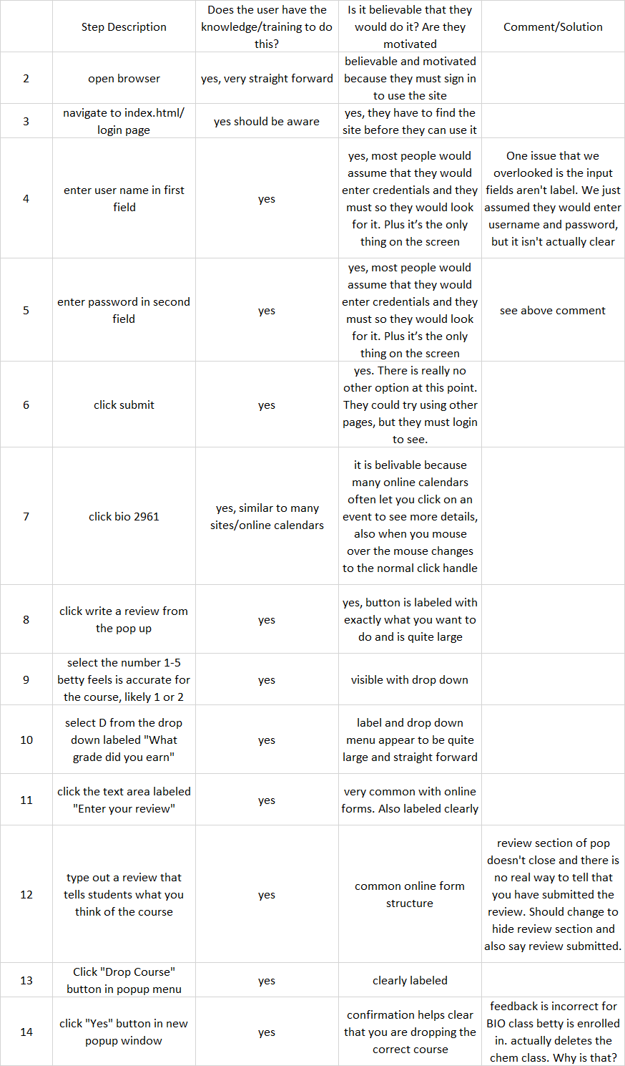
Milestone 4 - Cognitive Walkthrough
6 tasks were created, as well as the exact steps needed to perform each task
Example: You are a Biology major at WashU with the username “betty”. You are currently enrolled in BIO 2961 - Collaborative Phage Bioinformatics. You are currently getting a “D” in the course and are not enjoying it very much, so you wish to drop. Before you drop however, you want to write a review for the course to let future students know how you feel.

Slide 10
Milestone 4 - Cognitive Walkthrough
Changes made after Cognitive Walkthrough
Add user and password labels
Fix k-pop listing and Music 200
Needed to add sign out to class detail page
Change registration confirmation to a pop up window and on confirmation we reload the wishlist
Change task 5
You are a CS student named “sal”. You have completed most of your CS requirements, but you still haven’t completed all your humanities requirements. You want to finish up your requirements soon and hope to knock the humanities requirement off this semester.
Change the look of the enroll button to make it stand out from the rest of your wishlist
Change department name to full names
Added ability to search by course number

Slide 11
Milestone 4 - Round 3
Issues and concerns
Would like the option to select from all departments when searching
Would like to have enter key working as clicking submit for convenience
Review submission lacks confirmation message / pop-up
Keyword searching/indexing algorithm needs improvement for performance
Confirmation message are incorrect for dropping or enrolling courses
Display across screens of different resolutions
Overall, the major issues are with the intelligent borrowing since the users for testing are very familiar with current Webstac and brings the user habits to the new system.
Overall, the digital prototype is functional and system allows the fundamental tasks to be completed without external guidance.
The system can be further improved or refined by conducting more user testing and fixing the issues discovered through the testing.

Slide 12
Conclusions
Based on feedbacks from users, the redesigned registration provides more information and allows users to filter search results more easily
Users seemed to really be focused on a way to properly search courses.
If we did it again
Scrap the registration. Just focus on class search
Reviews didn’t seem as important to users once testing, maybe emphasis those more in tasks, or create the prototype to focus on reviewing courses

